Slide 1

Tired of Food Waste? Join Our SmartShelf Initiative!
Help us build a system to manage grocery expiry and reduce waste.

Slide 2
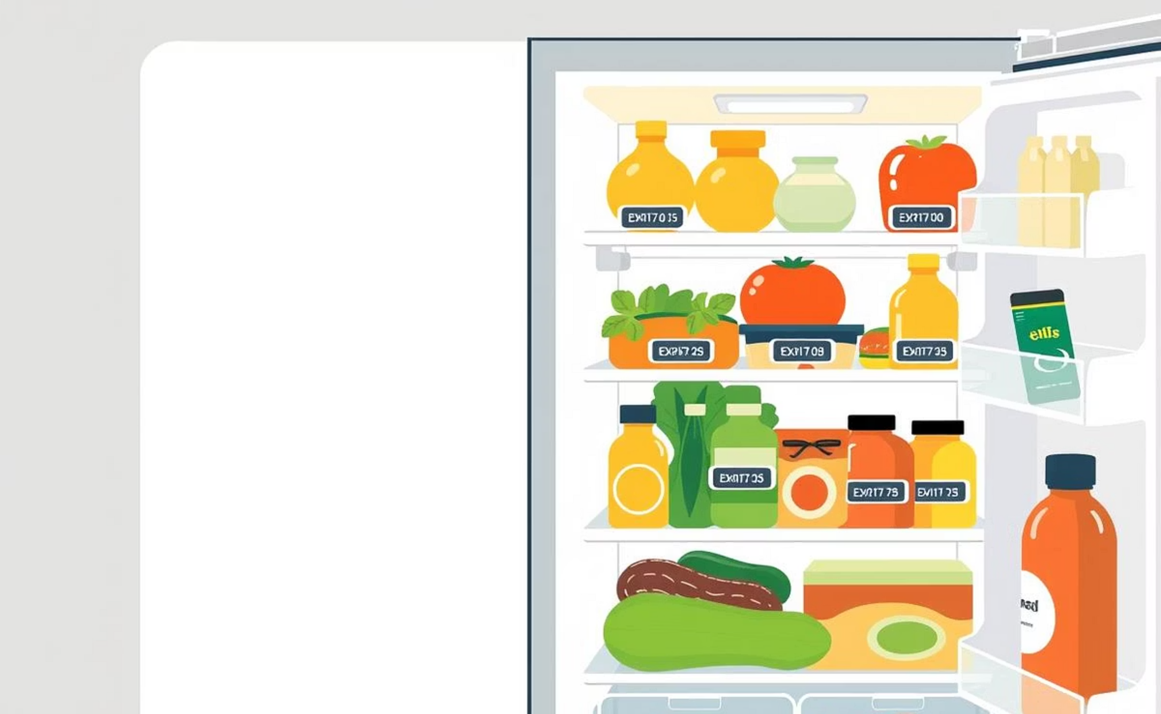
Smart Grocery Expiry Management System (SGEMS)
We're developing an innovative system to tackle food expiry issues for households and grocery shops.

Slide 3


Project Objectives: Track & Notify
Track Expiry Dates
Using barcode and QR code scanning.
Expiry Notifications
Get alerts for upcoming expiring products.

Slide 4


Project Objectives: Recipes & Analytics
Recipe Suggestions
Ideas for expiring ingredients.
Consumption Analytics
Insights for households and retailers.

Slide 5
Who Can Participate?
Grocery Shop Owners
And their staff.
Household Consumers
Individuals and families.

Slide 6
Community Involvement
Food Waste Advocates
Individuals concerned with reducing food waste.
Community Organizations
Working on food sustainability.

Slide 7
Why Join Us?
Share Experiences
Contribute your real-world insights.
Shape the Solution
Help design a community-focused system.

Slide 8
Benefits of Participation
Early Access
Test and use the system before public release.
Be Recognized
As a key contributor to an innovative local project.

Slide 9
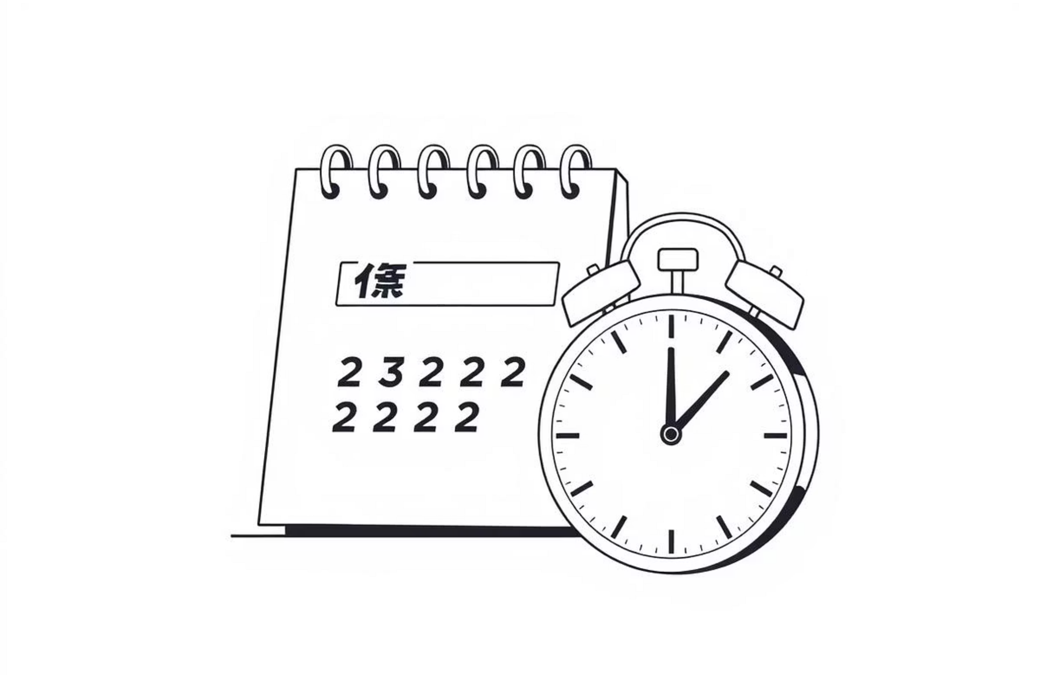
Tender Details
Tender No.: SGE2025/RAJAFKAR/001
Date: 29th July 2025
Submission Deadline: 22nd November 2025

Slide 10
Contact Us!
Ready to make a difference?
Email: praveerraj26@gmail.com
Phone: +91-91022-77117
Project Authors: Praveer Raj & Mohammad Afkar
Issued by: SmartShelf Development Team
Share this post to spread the word!

